Slide 1
INTRODUCTION:
Objective: Build a semantic HTML search system.
Features: HTML scraping, cleaning, tokenization, embeddings, vector search.
Stack: React (Frontend), FastAPI (Backend), Milvus (Vector DB).
Result: Intelligent retrieval of relevant text chunks from websites.

Slide 2
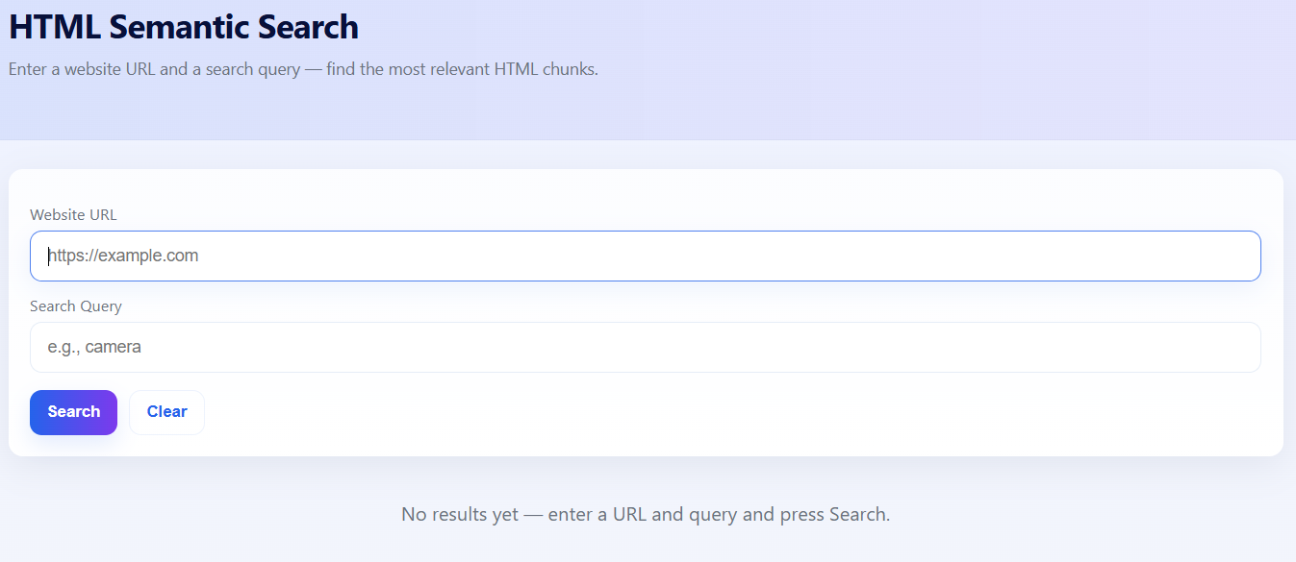
FRONTEND DESIGN :
Built using React + Vite for fast development.
Inputs: Website URL + Search Query.
Outputs: Top 10 semantic results displayed in cards.
UX: Minimal, responsive, error-handling, loading indicators.

Slide 3
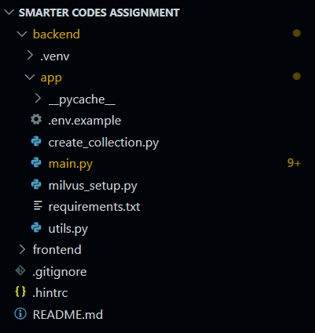
BACKEND DESIGN :
Fast API backend for routing and performance.
HTML parsing via Beautiful Soup, removes scripts/styles.
NLP Tokenization using NLTK into 500-token chunks.
Sentence Transformer model generates embeddings.

Slide 4
VECTOR DATABASE :
Milvus used for scalable vector storage & search.
Collection fields: chunk_text + embedding vector.
Query text converted to embedding → similarity search.
Returns top 10 most relevant semantic matches.

Slide 5
CONCLUSION :
Challenges: 403 blocks, HTML noise, NLP cleaning.
Learnings: Importance of clean preprocessing.
Future: Multi-page crawling, highlighting results, pagination, incremental indexing, authentication and user history.

